Slide 1
SAP Global Access Management Project - Focus Groups Kickoff
Structuring User Authorizations for Maxion Wheels Worldwide

Slide 2

Meeting Agenda: SAP Global Authorization Project - Focus Groups Kickoff
Project Overview (10 min)
Project scope and objectives
Business drivers
Expected business benefits
Global authorization principles
Focus Groups Role & Responsibilities (15 min)
Purpose of Focus Groups
Key responsibilities
User grouping process
Decision-making authority
Methodology & Data Overview (10 min)
Our approach and methodology
Data to be provided to Focus Groups
Analysis techniques (similarity index, outlier analysis)
Position-based grouping approach
Timeline & Key Milestones (5 min)
Communication Plan & Support (5 min)
Next Steps & Q&A (10 min)

Slide 3
Introduction & Project Overview

Slide 4





Project Scope & Objectives
Building a Standardized Global Authorization Framework
Implementation of standardized SAP authorizations across all Maxion Wheels locations
Alignment of user access rights with organizational roles and responsibilities
Enhancement of system security through proper segregation of duties monitoring
Optimization of access management processes

Slide 5





SAP Access Management Principles
Global Authorization Principles
Global positions will be established
Base authorizations will be determined for each position
Risk matrix will be implemented globally
Access management procedures and approach will be unified throughout Maxion

Slide 6
Focus Groups Role & Responsibilities

Slide 7
The Role of Focus Groups Your Critical Role in Authorization Design
Cross-functional teams of subject matter experts
Representing different functional areas globally
Responsible for defining standard authorization profiles
Bridge between technical implementation and business requirements

Slide 8
Focus Group Responsibilities
Key Activities in the Authorization Design Process
Analyze user-position role mappings
Review task assignments across positions
Group users based on position similarities
Validate authorization profiles
Provide functional expertise and feedback

Slide 9
Methodology

Slide 10
Our Approach
Collaborative Design & Implementation Methodology
Data-driven analysis of current usage patterns
Position-based role assignment
Collaborative validation sessions
Iterative refinement process
Controlled implementation

Slide 11
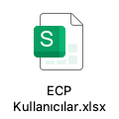


Data Provision
Information to Support Your Decision-Making
Information to Support Your Decision-Making
Creating Standardized Position-Based Roles
Global user-position role mappings
Detailed task assignments by user
Transaction codes with usage statistics
Current authorization assignments
System usage patterns and frequency
Group users with similar positions
Consider functional responsibilities
Align with organizational structure
Account for regional variations when necessary

Slide 12
Supporting Analysis
Technical Support Provided by the Consulting Team
Similarity index calculation
Outlier identification and analysis
Usage pattern analysis
Compliance verification & risk analysis

Slide 13
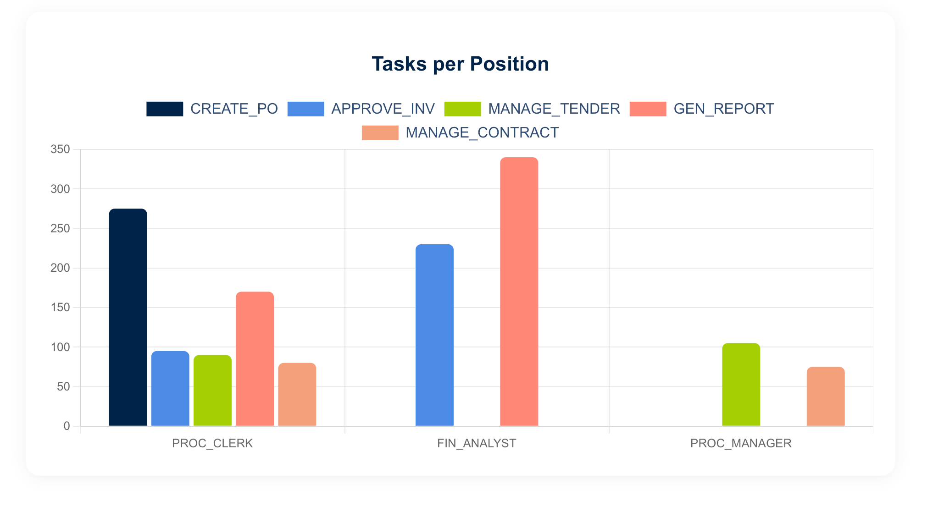
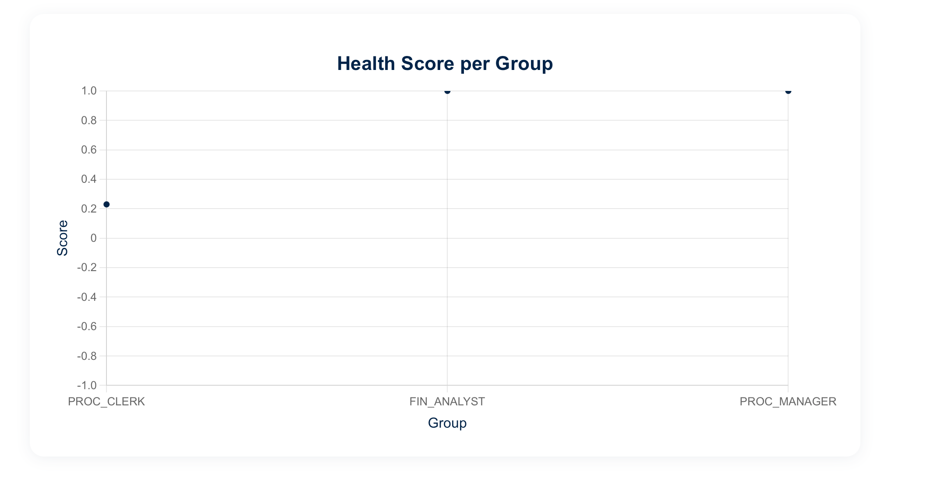
Similarity Index Calculation
Tasks per Position chart shows the number of SAP tasks executed per role, indicating functional responsibility across different positions.”
This scatter chart illustrates the internal consistency of task execution within each positional role.

Slide 14
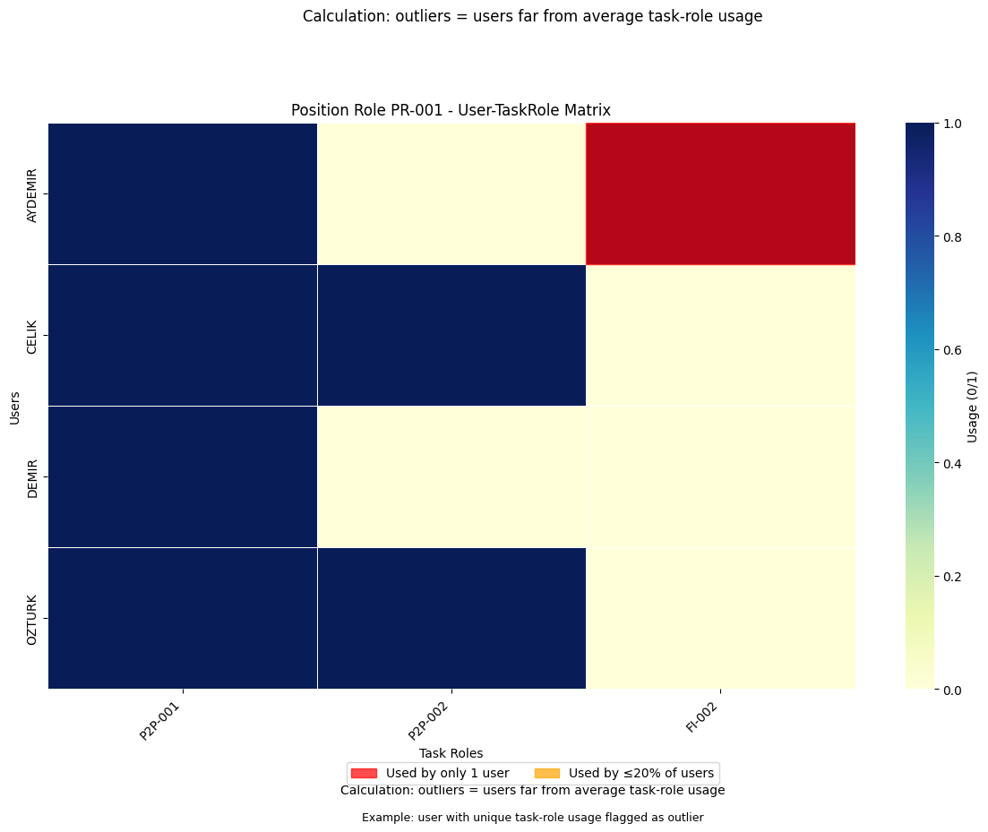
Outlier identification and analysis
This heatmap highlights users whose task-role usage significantly deviates from others within the same position, helping identify behavioral outliers.

Slide 15
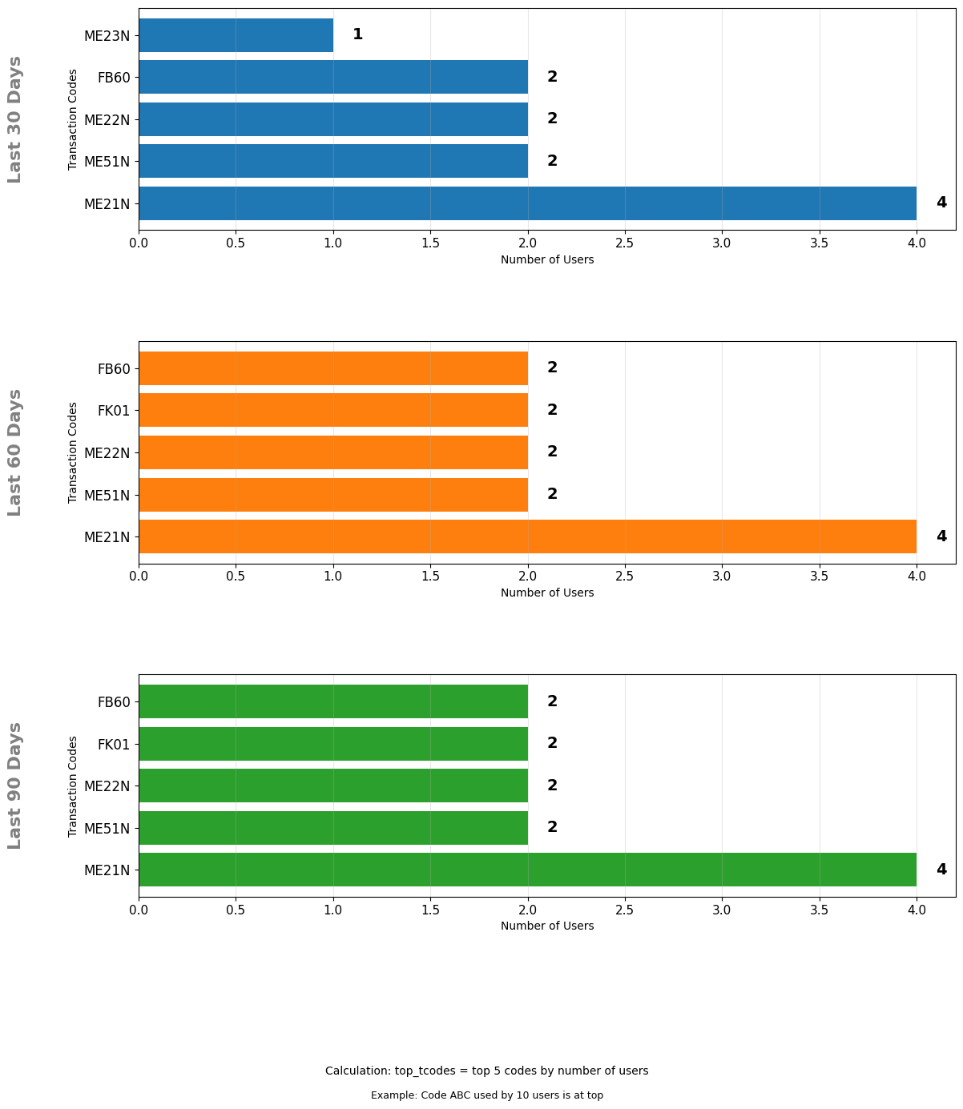
Usage Pattern Analysis
The left charts display the most frequently used SAP transaction codes over the last 30, 60, and 90 days. The right chart aggregates these activities by position, showing how often each task is executed per role.

Slide 16
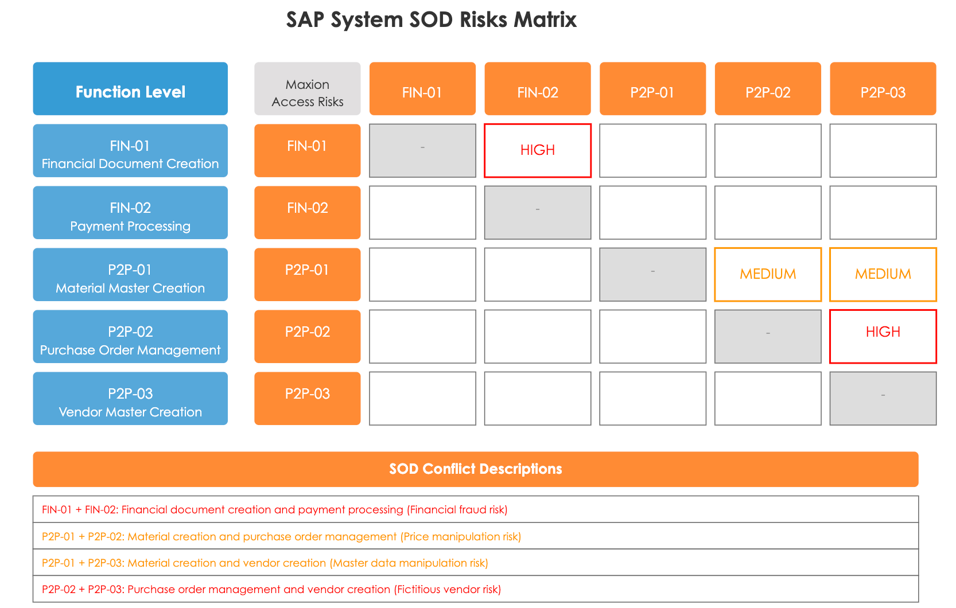
Compliance verification & risk analysis
The defined roles will be regularly reviewed against access risk principles to ensure compliance with SoD controls.

Slide 17
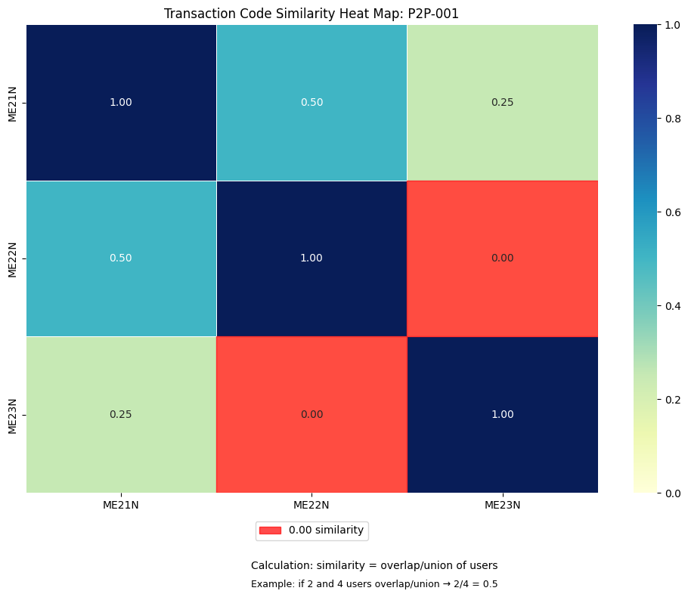
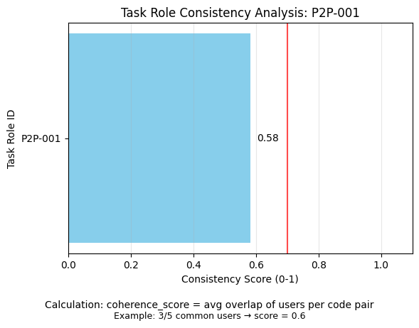
Appendix: Supporting Technical Insights Available

Slide 18
Project Timeline

Slide 19
Supporting Analysis
Key Milestones and Deadlines
Function | Sub-Function | Kickoff | WS-1 | WS-2 | WS-3
Supply Chain | Purchasing | 15.05.2025 | 22.05.2025 | 23.06.2025
Supply Chain | Inbound Logistics & Stores | 13.05.2025 | 23.05.2025 | 27.05.2025 | 10.06.2025
Supply Chain | Outbound Logistics & Warehouse | 14.05.2025 | 12.06.2025 | 19.06.2025
Sales & Marketing | BI, Sales, Marketing | 20.05.2025 | 28.05.2025 | 04.06.2025
Finance | Accounting, Treasury, Controlling | 30.05.2025 | 16.06.2025 | 20.06.2025
Quality/OPEX | Quality/OPEX | 21.05.2025 | 21.05.2025
Engineering | Process, Design, R&D | 16.05.2025 | 26.05.2025 | 03.06.2025
Operations | Planning, Production | 12.05.2025 | 02.06.2025 | 11.06.2025
Operations | Maintenance, Toolshop | 13.06.2025 | 18.06.2025 |  | 17.06.2025

Slide 20
Communication & Support

Slide 21
Communication & Support
Staying Connected Throughout the Process
Bi-weekly status update meetings
Dedicated support channel for Focus Group members
Documentation repository
Q&A sessions after each milestone
Continuous feedback mechanism
Consulting team available anytime for your questions and support

Slide 22
Next Steps

Slide 23
Next Steps
Immediate Actions
Review provided data package (by May 20)
Schedule functional team discussions
Prepare questions for first workshop
Identify potential regional differences

